Slide 1
Microprocessors, Microcontrollers & Embedded systems
8051 architecture

Slide 2
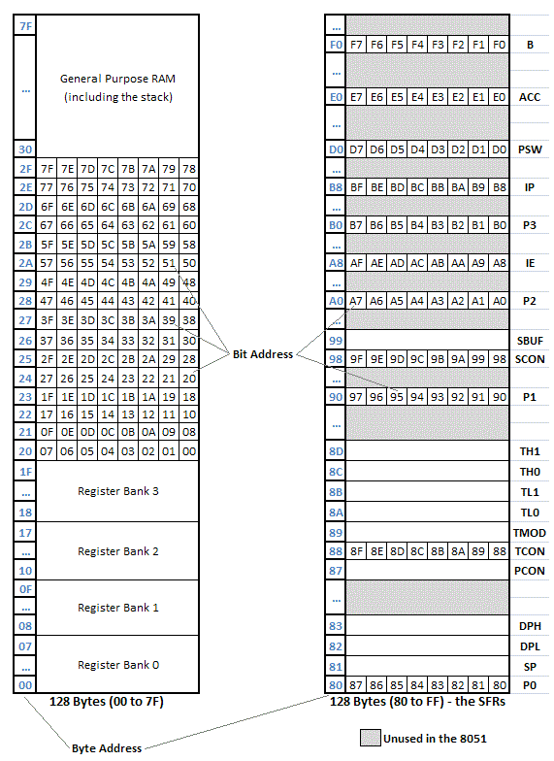
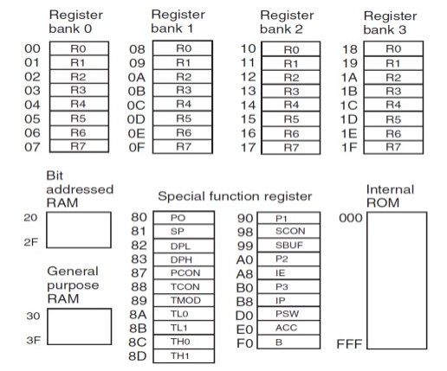
8051 Programming model
Internal ROM address: 0x000-0xFFF
Internal RAM address: 0x00-0x7F
Four register banks: 0x00-0x1F
Bit addressed RAM: 0x20-0x2F
General purpose RAM: 0x30-0x7F
Special function Registers
Specific addresses between 0x80-0xF0
External memory access:
If EA = 0, external address: 0x1000-0xFFFF
If EA = 1, external address: 0x0000-0xFFFF
7F
8051 programming model
Notes:
EA = 0 implies EA bar = 1

Slide 3
8051 Special function registers
Accumulator
B Register
PC
PSW
SP
Data pointer
Ports 0 to 3: P0, P1, P2, P3
Serial data buffer SBUF
Timer Registers: (TH0, TL0) & (TH1, TL1)
Control registers: IP, IE, TMOD, TCON, SCON & PCON: Contain the control and status bits for interrupts, timers/counters & serial port
Refer to 8051 datasheet: Page 8
https://www.nxp.com/docs/en/data-sheet/8XC51_8XC52.pdf
Each of these registers have an 8-bit address except the PC
Why is the address necessary?
Notes:
Typically, arithmetic and logical operations take place during Phase 1 and internal register-to-register transfers take place during Phase 2.

Slide 4
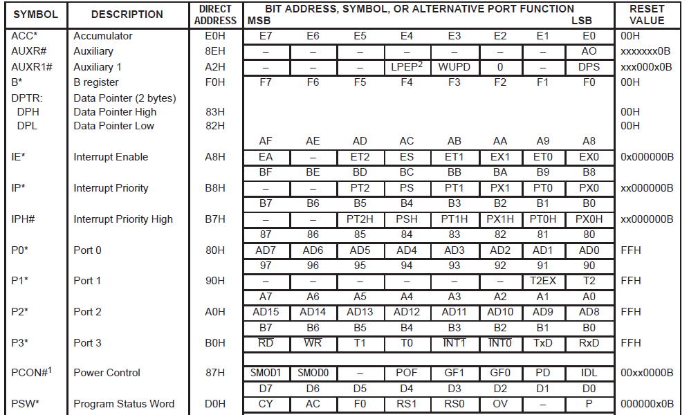
8051 Special function registers
Present in new variants of 8051
Present in new variants of 8051

Slide 5
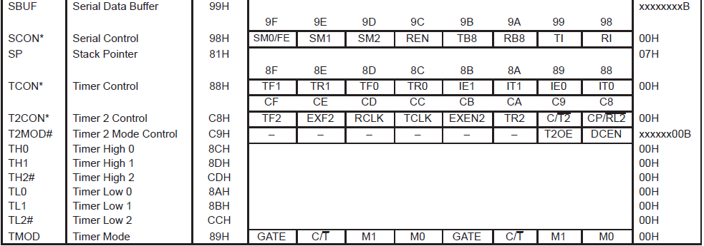
8051 Special function registers
Notes:
Typically, arithmetic and logical operations take place during Phase 1 and internal register-to-register transfers take place during Phase 2.

Slide 6
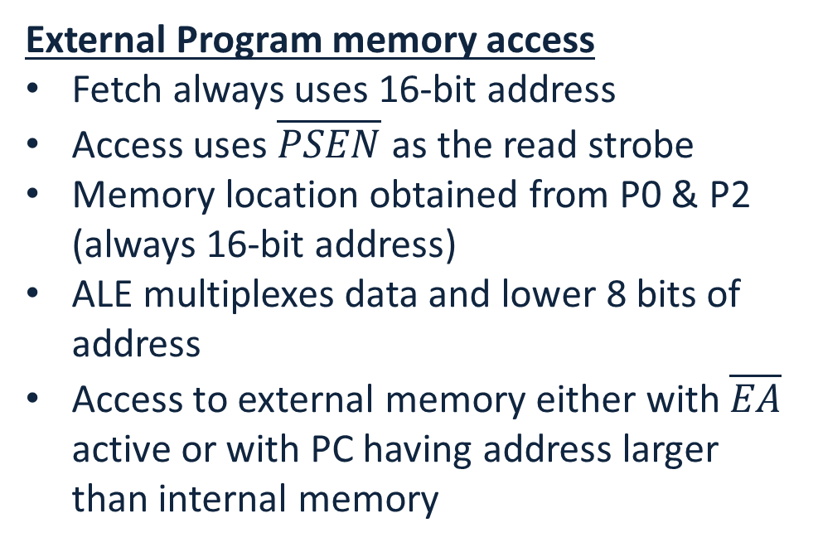
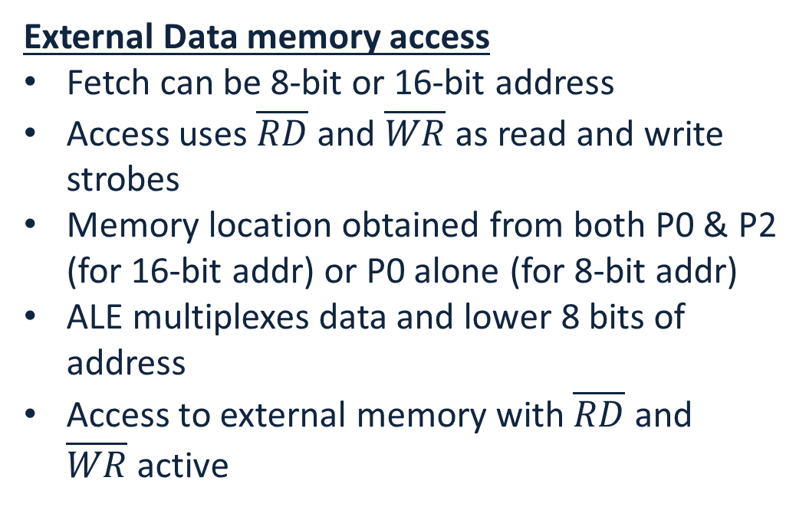
8051 External memory interface
External memory interface up to 64kbytes of Program and/or data memory possible
External Program memory access
Fetch always uses 16-bit address
Access uses $\overline{PSEN}$ as the read strobe
Memory location obtained from P0 & P2 (always 16-bit address)
ALE multiplexes data and lower 8 bits of address
Access to external memory either with $\overline{EA}$ active or with PC having address larger than internal memory
External Data memory access
Fetch can be 8-bit or 16-bit address
Access uses $\overline{RD}$ and $\overline{WR}$ as read and write strobes
Memory location obtained from both P0 & P2 (for 16-bit addr) or P0 alone (for 8-bit addr)
ALE multiplexes data and lower 8 bits of address
Access to external memory with $\overline{RD}$ and $\overline{WR}$active
Notes:
Typically, arithmetic and logical operations take place during Phase 1 and internal register-to-register transfers take place during Phase 2.

Slide 7
















8051 External Program memory interface
External Program memory with internal ROM
External Program memory without internal ROM
$$5V$$
$$0xFFFF$$
$$0xFFFF$$
8051 microcontroller
$$AD0−7$$
External
Program
memory
(60K)
8051 microcontroller
$$AD0−7$$
External
Program
memory
(64K)
P0
D0-D7
P0
D0-D7
$$\overline{EA}$$
Latch
A0-A7
$$\overline{EA}$$
Latch
$$ALE$$
$$ALE$$
A0-A7
P2
A8-A15
P2
A8-A15
$$\overline{PSEN}$$
$$\overline{OE}$$
$$GND$$
$$\overline{PSEN}$$
$$\overline{OE}$$
$$0x1000$$
$$0x0000$$
Internal ROM 4K
(0x0000-0x0FFF)
Internal ROM 4K
(0x0000-0x0FFF)
8-bit latch such as 74LS373 to demultiplex data and address lines

Slide 8
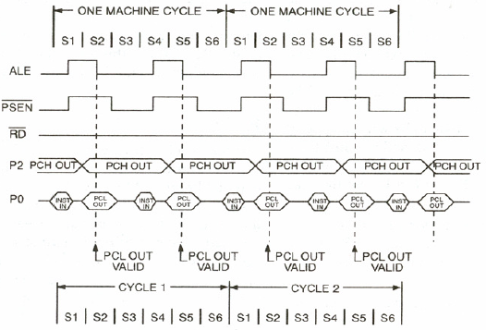
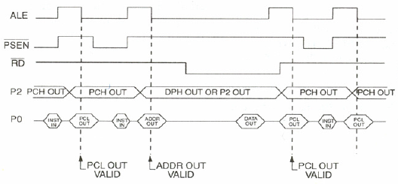
8051 External Program memory interface
External Program memory execution
(A)
(B)
When is (A) used & when is (B) used?
From 8051 Hardware manual
Notes:
When internal data memory is being used (i.e., without using MOVX instructions), the execution in (A) is adopted.
When external data memory is used (i.e., with MOVX instructions), the execution in (B) is adopted

Slide 9






8051 External Data memory interface
External Data memory with internal ROM
External Program & Data memory
$$5V$$
$$0xFFFF$$
$$0xFFFF$$
8051 microcontroller
$$AD0−7$$
External
Data
memory
(64K)
8051 microcontroller
$$AD0−7$$
External
Program
memory
(64K)
P0
D0-D7
P0
D0-D7
$$\overline{EA}$$
Latch
A0-A7
$$\overline{EA}$$
Latch
$$ALE$$
A0-A7
P2
A8-A15
P2
A8-A15
$$\overline{RD}$$
$$\overline{OE}$$
$$\overline{PSEN}$$
$$\overline{OE}$$
$$\overline{WR}$$
$$\overline{WR}$$
$$GND$$
$$0x0000$$
$$0x0000$$
$$0xFFFF$$
External
Data
memory
(64K)
D0-D7
Internal ROM 4K
(0x0000-0x0FFF)
A0-A7
A8-A15
$$\overline{RD}$$
$$\overline{OE}$$
$$\overline{WR}$$
$$\overline{WR}$$
$$0x0000$$
Is anything missing?
Is something wrong?
Notes:
ALE is missing

Slide 10
Interfacing additional peripherals with 8051
IO-mapped IO
Computer/controller uses two separate address spaces for memory & IO devices
Available addresses for memory is unaffected by IO
Instructions used for IO & memory operations are different
Limited number of IO that can be interfaced
Efficient
Memory-mapped IO
Computer/controller uses the same address space for memory & IO devices
Available addresses for memory is reduced due to IO
Instructions used for IO & memory operations are same
Significantly large number of IOs can be interfaced
Less efficient
Why is Memory-mapped IO less efficient?
Notes:
Memory-mapped I/O has to send address of the I/O in the first two memory cycles and then data can be parsed to I/O. In IO-mapped IO, data can be parsed directly with the control signal concurrently parsed.

Slide 11



















8051 with 8255
Intel 8255
Programmable peripheral interface
I/O mapped I/O
Memory mapped I/O
$$5V$$
$$5V$$
$$AD0−7$$
8051 microcontroller
8255
8051 microcontroller
74LS245
8255
P0
D0-D7
P0
D0-D7
PA0-PA7
PA0-PA7
$$\overline{EA}$$
$$\overline{RD}$$
$$\overline{RD}$$
$$\overline{EA}$$
$$\overline{RD}$$
$$\overline{RD}$$
$$\overline{WR}$$
$$\overline{WR}$$
PB0-PB7
$$\overline{WR}$$
$$\overline{WR}$$
PB0-PB7
PC0-PC7
PC0-PC7
$$A0$$
$$RST$$
$$A0$$
$$RST$$
$$A1$$
$$\overline{CS}$$
$$A1$$
$$GND$$
$$\overline{CS}$$
$$BA0$$
$$P1.0$$
Latch
$$BA1$$
$$P1.1$$
$$RST$$
$$RST$$
$$BA8−15$$
Decoder
P2
$$Y0$$

